Slide 1

Employee Pay Roll

Slide 2





Project Team
Prasanna Kumar
Karan Kotian
Parth Parmar
Shivangi
Aishwarya

Slide 3

Employee Pay Roll
Result
Data Set
Employee retention
Trending job title
Clean up
Share result
EDA
Trend analysis
When scaling, group all elements to be scaled. Scale as needed. Use the “Increase Font Size,” “Decrease Font Size” buttons or manually change the font size for the editable text.

Slide 4
Project Proposal
01
Base pay analysis
02
Employee Experience
03
Base pay against experience
04
Base pay of freshers in different Job title
Base pay against Bureau
05
06
Highest retention rate in Bureau – Top 10

Slide 5
What motivates us to explore the Employee Payroll?
How does the base pay of freshers in different job titles compare to industry standards, and are adjustments needed to attract and retain top talent in these roles?
What is the correlation between employee experience and base pay, and how can this information be used to optimize compensation strategies and improve overall employee satisfaction and retention?
What are the key factors contributing to the highest retention rates in the top 10 bureaus, and how can these insights be leveraged to drive overall business success and enhance the employee experience?

Slide 6
What to explore the Employee Payroll Study dataset ?
Base pay analysis involves examining and evaluating the compensation provided to employees in the form of their fixed wages or salaries, without taking into account any bonuses, commissions, or other variable pay components.
Employee experience refers to the overall perception and satisfaction of employees in their interactions, engagement, and journey within an organization, encompassing their physical, emotional, and cognitive experiences.
Base pay against experience refers to the analysis and comparison of employees' wages or salaries in relation to their years of experience or level of expertise, to determine if there is a correlation between pay and experience levels within an organization.
Highest retention rate in bureau signifies the percentage of employees who remain employed in the organization over a specific period of time, indicating a successful employee retention strategy and positive workforce stability within the bureau.
Notes:
Karan

Slide 7
Problem statements that could be addressed using this dataset:
Identifying and addressing disparities in pay
Improving employee retention
Ensuring compliance with labor laws and regulations

Slide 8
Who benefits from this project?
Employers can use payroll data analysis to evaluate the performance of their employees, monitor their attendance, and determine their pay rates
HR Departments: Human resources departments can use payroll data analysis to identify trends and patterns in employee performance, satisfaction, and retention
Government agencies: Government agencies can use payroll data analysis to monitor compliance with labor laws
Researchers: Researchers can use payroll data analysis to investigate labor market trends and identify patterns
Financial analysts: Financial analysts can use payroll data analysis to evaluate the financial performance of a company by examining employee costs and productivity

Slide 9
First Name
Fiscal Period
Last Name
Middle Init
Bureau
Job Title
Office Name
Categorical
Fiscal Year
Fiscal Quarter
Job Code
Position ID
Integer
Employee Payroll Data Types
Employee Identifier
Unique
Original Hiring Date
Date time
Office
Base Pay
Float

Slide 10
EDA
The first step is to examine the data to ensure it is in the correct format and structure. This may involve checking the data types, variable names, and variable formats.
Data exploration
Once the data is clean, the next step is to explore the data to understand its distribution, variance, and relationships between variables.
Data preprocessing
After exploring the data, the next step is to preprocess the data, which may involve scaling or normalizing the data, encoding categorical variables, or reducing the dimensionality of the data
Data inspection

Slide 11
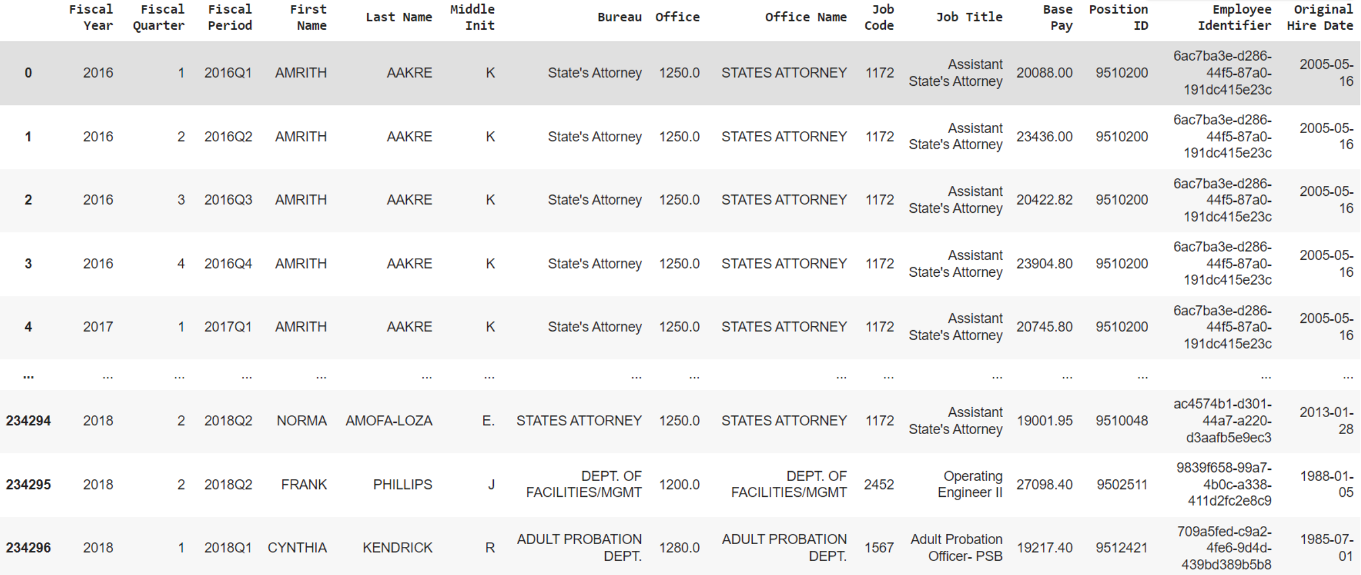
Data set

Slide 12
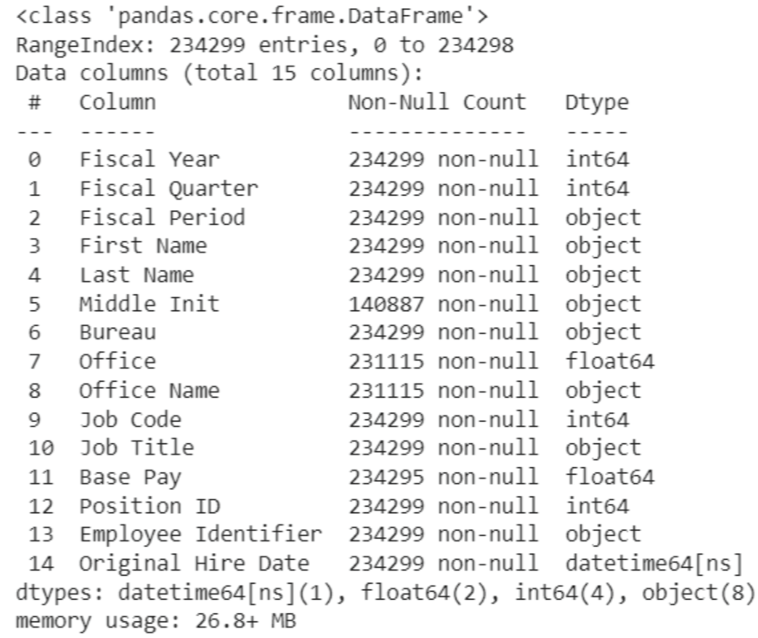

Dimension & Summary of Data
234299
15
Notes:
Aish

Slide 13
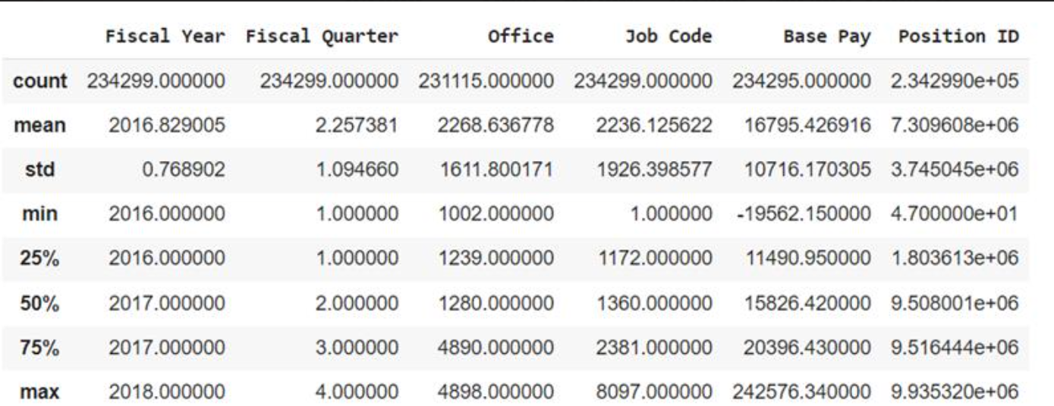
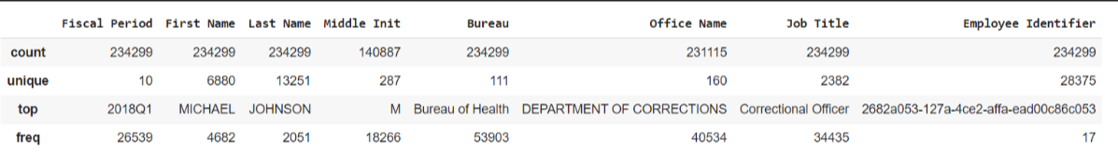
Description of Numeric & Categorical features
Notes:
Shivaangi

Slide 14
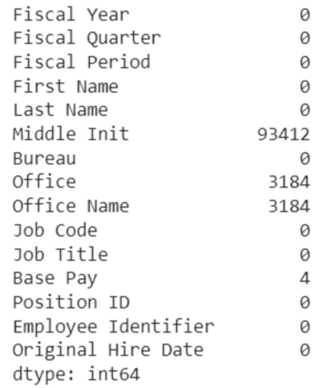
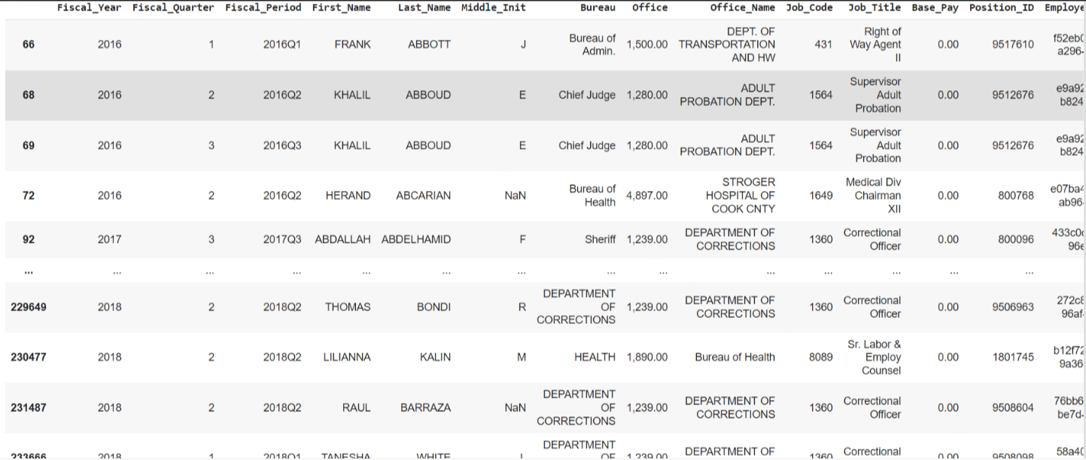
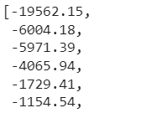
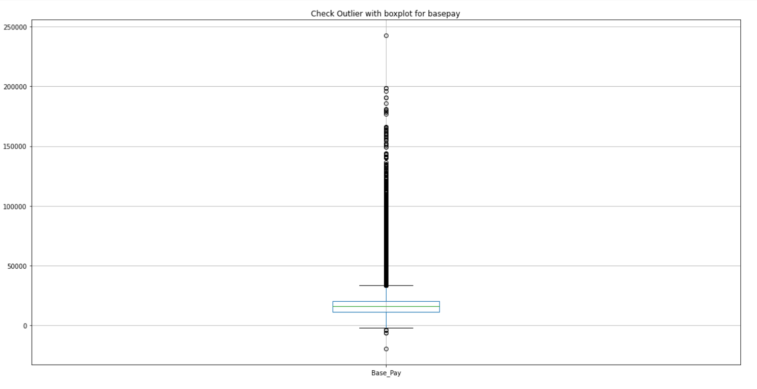
Identified errors in the data set
Null values in data set
Negative values are mentioned in Base Pay
Zero value in Base Pay
Potential outliers

Slide 15
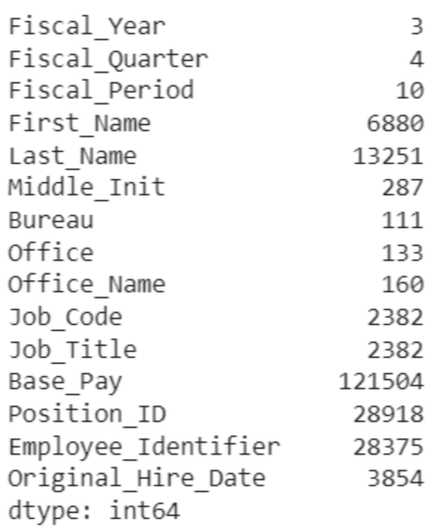
Unique Values of each feature

Slide 16
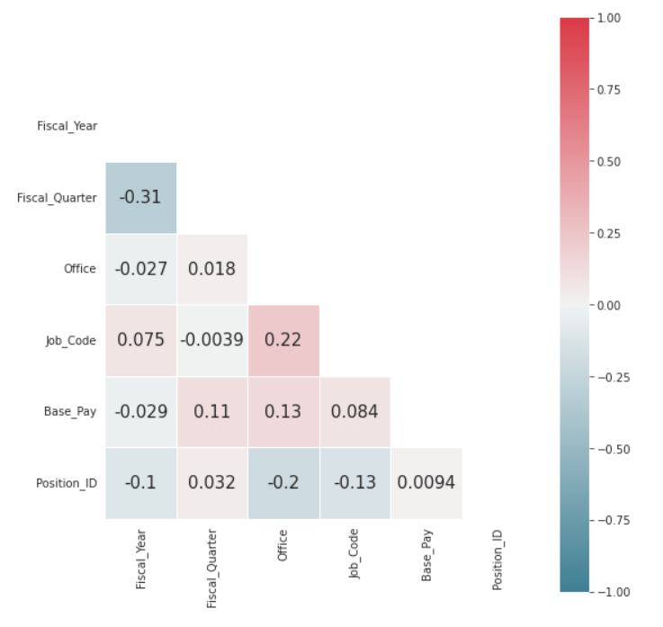
Correlation between features

Slide 17
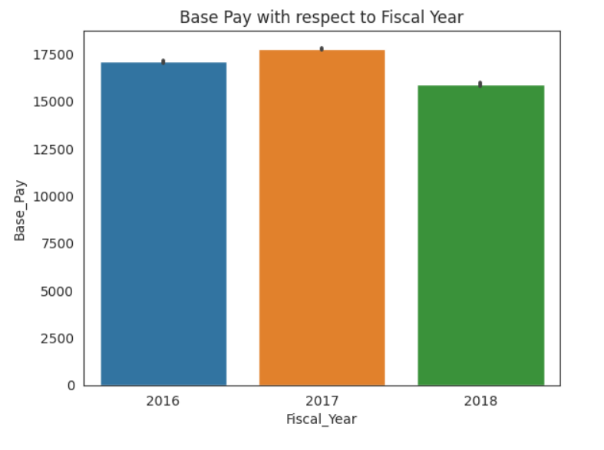
Base pay for three diff years

Slide 18
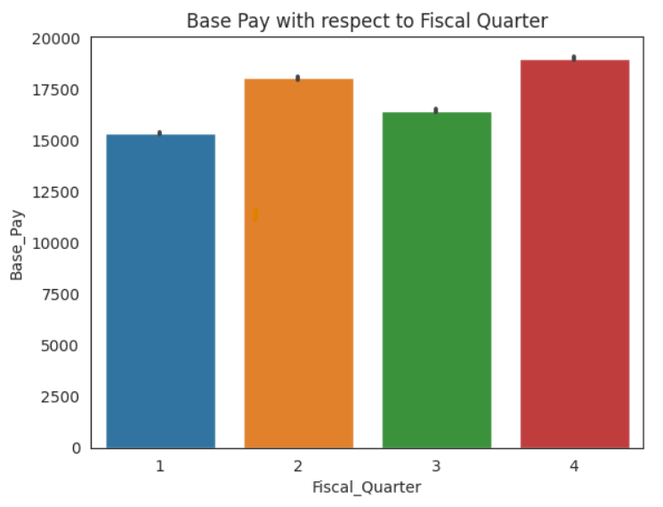
Base pay across Fiscal Quarter

Slide 19
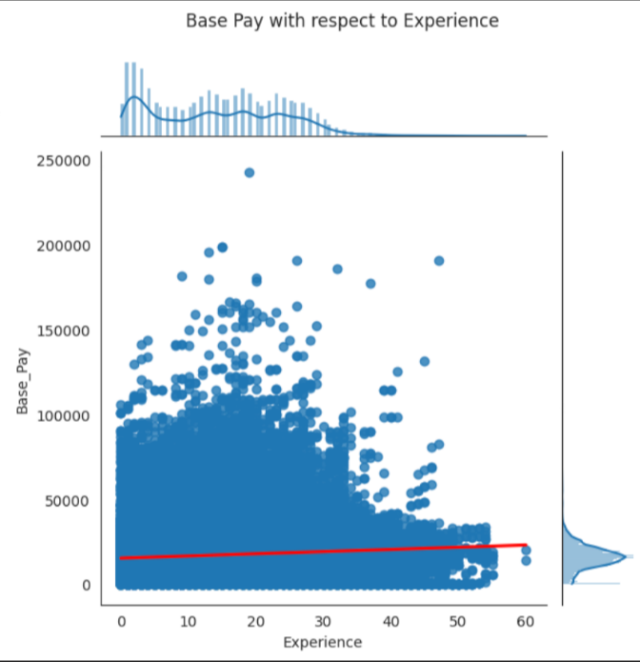
Base pay for different experience level

Slide 20
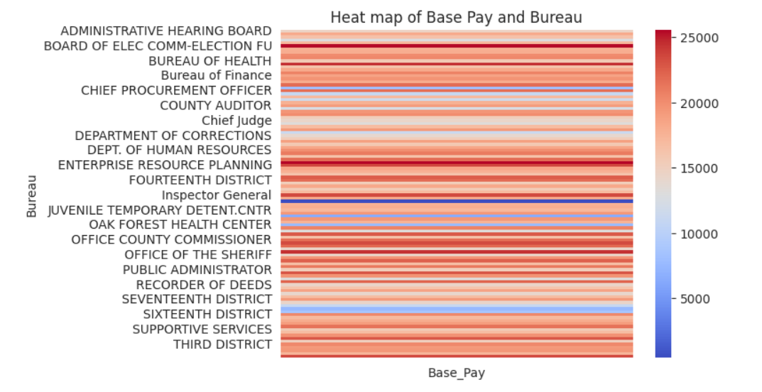
Base pay for different Job titles

Slide 21
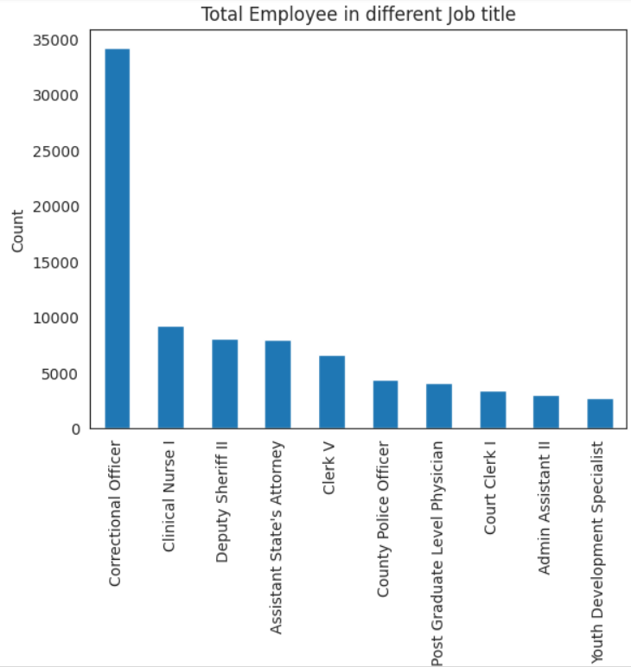
Total number of Employee in different job title

Slide 22
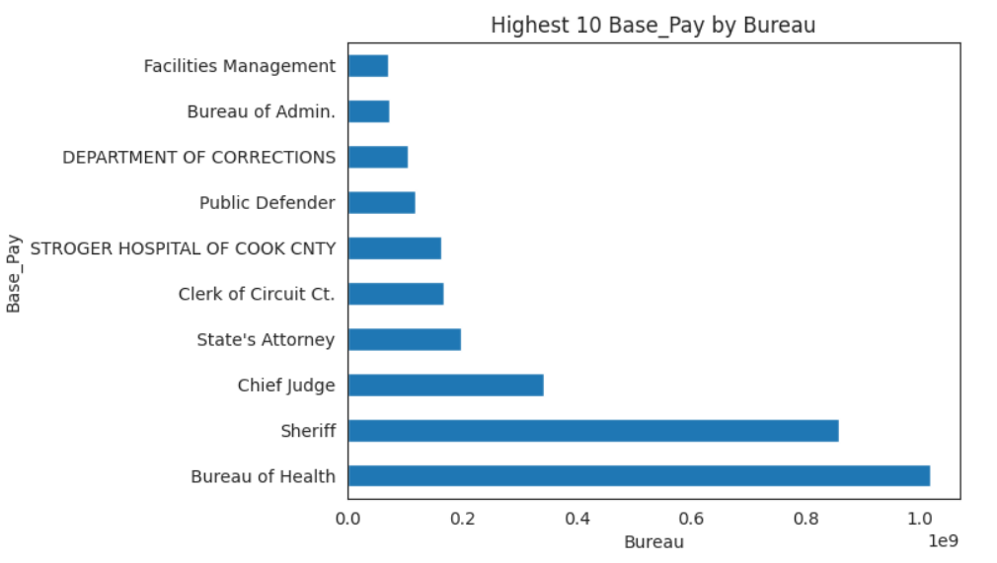
Top 10 Bureau that pay high salary

Slide 23
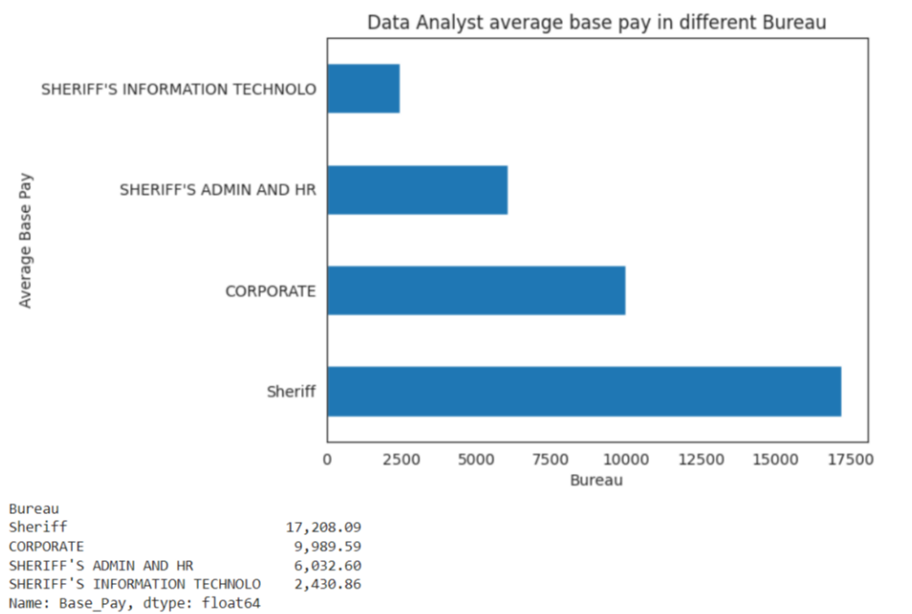
Data Analyst Base pay in different Bureau

Slide 24
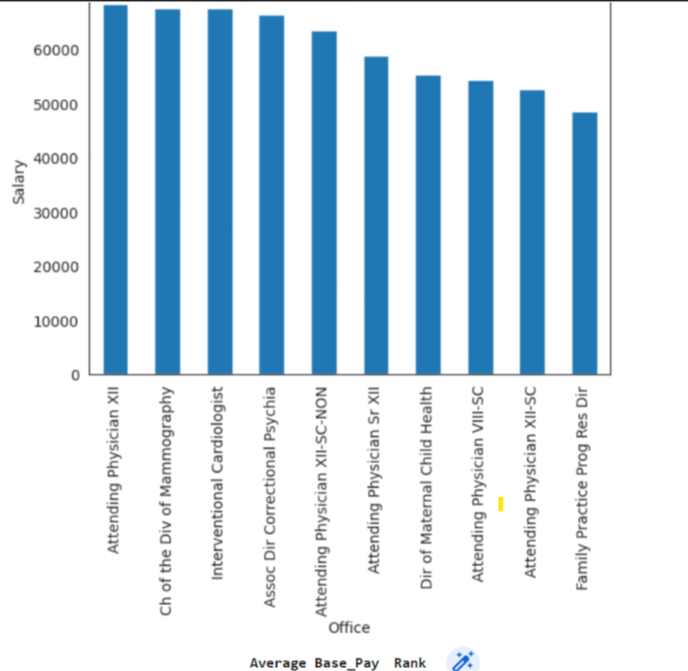
High paid job titles
Employers can keep this as bench mark
Notes:
By referring this trend Employer can fix the base pay for the given job titles. Also, when they are looking for resource from the market, they can refer this trend as bench mark.

Slide 25
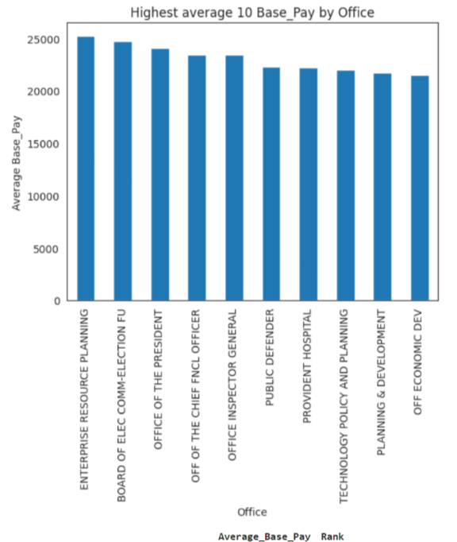
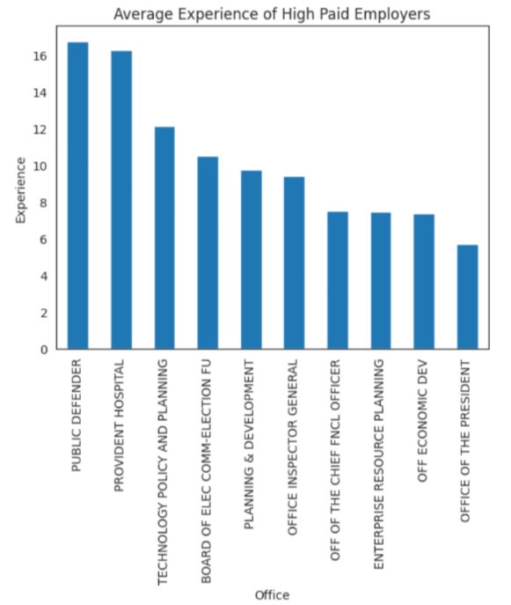
Retention rate of the above mentioned employers are high, since their average base pay is high.
Notes:
We are taking top 10 offices whose base pay is higher than the average base pay identified in the market and that’s the reason employees work in these offices are retained for longer period of time.

Slide 26
Conclusion from analysis
Use the analysis of base pay, employee experience, base pay against experience, base pay of freshers in different job titles, base pay against bureau, highest retention rate in bureau (top 10), and employee count in each office (top 10) to inform strategic decisions related to compensation. Ensure that base salaries are competitive and aligned with industry standards to attract and retain top talent.
Utilize the findings to enhance talent acquisition strategies by identifying job titles and experience levels that may require adjustments in base pay to optimize employee satisfaction and retention.
Utilize the insights gained from the analysis to drive overall business success and enhance the overall employee experience within the organization by aligning compensation, talent acquisition, retention, and office location strategies with the findings.

Slide 27
Recommendation based on analysis
Review and adjust compensation structure: Conduct a thorough review of the current compensation structure and benchmark it against industry standards to ensure that base salaries are competitive and aligned with market rates. Consider revising the base pay structure to offer more competitive salaries to employees, particularly those in roles where high turnover rates have been observed.
Conduct salary market research: Regularly conduct salary market research to stay updated on industry trends and ensure that the organization's base pay remains competitive in attracting and retaining top talent. Use this research to identify areas where base pay may need to be adjusted to better align with the market and retain skilled employees.
Provide career development opportunities: Offer opportunities for career growth and development to employees, including training programs, mentorship, and advancement opportunities. Employees are more likely to stay with employers who invest in their professional growth and offer a clear career path.
Monitor turnover rates: Continuously monitor turnover rates and analyze trends to identify any areas where base pay may be impacting retention negatively. Take proactive measures to address any issues identified and continuously evaluate and adjust the compensation strategy to align with the organization's retention goals.
By implementing these recommendations, the organization can enhance its compensation strategy, attract and retain top talent, and ultimately improve employee retention and organizational success.

Slide 28
Links used in this project
Github: https://github.com/Prasanna2090/Team03_EmployeePayroll_Project.git
Data set link: https://catalog.data.gov/dataset/employee-payroll

Slide 29
Reference
Citation:
https://seaborn.pydata.org/generated/seaborn.heatmap.html
https://seaborn.pydata.org/tutorial/distributions.html
https://stackoverflow.com/questions/70176771/how-to-make-a-histogram-with-percent

Slide 30
Thank you…..

